Slide 1
Class 설계서
2조
Mixharmony

Slide 2
변경 이력
일자 | 버전 | 변경 내역 | 작성자
2017.05.17 | 0.1ver | To do 항목에 대한 클래스 초안 작성 | 김주원
2017.05.17 | 0.2ver | 수강 과목에 대한 클래스 초안 작성 | 김주현
2017.05.19 | 0.3ver | Alarm 관리,연동 로그인,아웃 클래스 초안 작성 | 정승환
2017.05.19 | 0.4ver | Database, TodoItem, TodoList 항목 초안 작성 | 윤승현
2017.05.19 | 0.5ver | 수강 과목에 대한 클래스 내용 추가 | 김주현
2017.05.19 | 0.6ver | To do 항목에 대한 클래스 내용 추가 및 수정 | 김주원
2017.05.26 | 0.7ver | Subject에 대한 클래스 추가 및 내용 수정 | 김주현

Slide 3
2017.05.26 | 0.8ver | To do 항목에 대한 클래스 내용 수정 | 김주원
2017.05.26 | 0.9ver | Subject와 To do 항목들에 대한 Sort 관련 클래스 추가 | 구보선
2017.05.26 | 1.0ver | Subject, To do 항목에 대한 클래스 내용 정리 | 김주현
2017.05.26 | 1.1ver | 전체적인 클래스 내용 수정 및 정리 | 김주현
2017.05.26 | 1.2ver | Login, Logout 클래스 내용 수정 | 정승환
2017.05.26 | 1.3Ver | Class map 추가 | 오소정
2017.05.26 | 1.4ver | 최종 수정 | 오소정

Slide 4
To Do List Program
Main()
public static Login LoginClass;
- public static void main(String[] args)

Slide 5
To Do List Program
Login()
private JPanel contentPane; private JTextField School_Tf; private JTextField Id_In; private JTextField Password_Tf; private JComboBox Select_School_Btn; private JButton Login_Btn; private JCheckBox Stay_Login_Btn; private JTextField Id_Tf; private JPasswordField Password_In; private static final String DRIVER; private static final String URL; private static final String USER; private static final String PASS; | JTextField textField_ID; JTextField textField_PW; JCombobox combobox; JButton btnConnect; public DefaultComboBoxModel model; JLabel School_Img; JLabel Id_Img; JLabel Password_Img;
public Login() public Connection getConn() public void actionPerformed(ActionEvent arg0) - public void DefaultComboBoxModel()

Slide 6
To Do List Program
윈도우 창 | 텍스트영역 | 체크박스영역 | 콤보 박스영역 | 버튼영역
 | 아이디 비밀번호 | 로그인 상태 유지 | 학교명 | 접속
 |  |  | 입력된 교명에서 선택한다

Slide 7
To Do List Program
Logout()
private JPanel contentPane; JButton btnLogout;
- public Logout() - public void actionPerformed(ActionEvent e)

Slide 8
To Do List Program
Subject_Management()
private JPanel contentPane; private JScrollPane scrollPane; private JTable Subject_Data_Tb; JButton Add_Subject_Btn; JButton Subject_Scroll; JButton btnNewButton; JButton Alarm_Btn; JButton New_Alarm_Btn; JScrollPane Subject_Data_Scroll; JComboBox comboBox;
- public Subject_Management() - public void mouseClicked(MouseEvent arg0) - public void mouseExited(MouseEvent arg0) - public void mousePressed(MouseEvent arg0)
윈도우 창 | 테이블 영역 | 버튼
 | 등록되어있는 과목 정보 | 버튼 명
 | 출력한다 | +(추가버튼) 알림(아이콘) 정렬 Log out

Slide 9
To Do List Program
Add_Subject()
private JPanel contentPane; private JTextField Subject_Tf; private JTextField Subject_In; private JTextField Professor_Tf; private JTextField Professor_In; private JTextField Dayofweek_Tf; private JTextField Period_Tf; private JTextField Dayofweek_In; private JTextField Period_In; private JTextField Year_Tf; private JTextField Semester_Tf; private JTextField Year_In; private JTextField Semester_In; private JTextField Divclass_Tf; private JTextField Divclass_In; | JLabel Subject_Img; JLabel Professor_Img; JLabel Dayofweek_Img; JLabel Period_Img; JLabel Year_Img; JLabel Semester_Img; JLabel Divclass_Img; JButton Check_Btn;
- public Add_Subject() - private void ViewData(Subject_Dto vSub) - private void Insert_Subject() - public Subject_Dto getViewData() - public void mousePressed(MouseEvent arg0)
윈도우 창 | 텍스트 영역 | 버튼
 | 과목명 | 버튼 명
 | 담당교수
 |  | 등록 확인
 | 강의 요일 및 시간
 | 수강학기 및 년도
 | 분반

Slide 10
To Do List Program
Change_Subject()
private JPanel contentPane; private JTextField Subject_Tf; private JTextField Subject_In; private JTextField professor_Tf; private JTextField Professor_In; private JTextField Dayofweek_Tf; private JTextField Period_Tf; private JTextField Dayofweek_In; private JTextField Period_In; private JTextField Year_Tf; private JTextField Semester_Tf; private JTextField Year_In; private JTextField Semester_In; private JTextField Divclass_Tf; private JTextField Divclass_In; | JPanel panel; JLabel Subject_Img; JLabel Professor_Img; JLabel Dayofweek_Img; JLabel Period_Img; JLabel Year_Img; JLabel Semester_Img; JLabel Divclass_Img; JButton Check_Btn;
- public Change_Subject() - private void Insert_Subject() - public void mousePressed(MouseEvent arg0)
윈도우 창 | 텍스트 영역 | 테이블 영역 | 버튼
 | 과목명 | 선택한 과목 정보 | 버튼 명
 | 담당교수 |  | 변경 수정하기
 | 강의 요일 및 시간 | 출력한다
 | 수강학기 및 년도
 | 분반

Slide 11
To Do List Program
Delete_Subject()
private JPanel contentPane; JTextArea Warning_Out; JButton Cancel_Btn; JButton Check_Btn;
- public Delete_Subject() - public void mouseClicked(MouseEvent e)
윈도우 창 | 버튼
 | 버튼 명
 | 제거

Slide 12
To Do List Program
Subject_Dao()
private static final String DRIVER; private static final String URL; private static final String USER; private static final String PASS; Subject_List SList;
- public Subject_Dao() - public Subject_Dao(Subject_List SList) - public Connection getConn() - public Subject_Dto getSubject_DtO(String subject) - public Vector getSubject_List() - public boolean Insert_Subject(Subject_Dto dto) - public boolean Change_Subject(Subject_Dto vSub) - public void userSelectAll(DefaultTableModel model)

Slide 13
To Do List Program
Subject_Dto()
private String subject; private String professor; private String dayofweek; private String period; private String year; private String semester; private String divclass;
- public void setSubject(String subject) - public String getProfessor() - public void setProfessor(String professor) - public String getDayofweek() - public void setDayofweek(String dayofweek) - public String getPeriod() - public void setPeriod(String period) - public String getYear() - public void setYear(String year) - public String getSemester() - public void setSemester(String semester) - public String getDivclass() - public void setDivclass(String divclass) - public String toString()

Slide 14
To Do List Program
Sort_Subject()
private Database database; Public Subject_Management; Subject_Management_Class; public Add_Subject_Class; JButton DayofweekBtn;
- public getInfo_print() - Public Sort_Subject () - class Dayofweek_sort() - class DayofweekBtnListener()
윈도우 창 | 테이블 영역 | 버튼
 | 등록되어있는 Subject 항목들 정렬 | 버튼 명
 | 출력한다 | - 요일별 정렬

Slide 15
To Do List Program
Todo_Management()
private JPanel contentPane; private JTable Todo_Data_Tb; JButton Add_Todo_Btn; JButton Logout_Btn; JButton Subject_Btn; JScrollPane Todo_Scroll; JButton Importance_Btn; JComboBox Sort_Btn;
- public Todo_Management() - public void mousePressed(MouseEvent arg0)
윈도우 창 | 테이블 영역 | 버튼 | 콤보 박스 영역
 | 등록되어있는 To do 항목들 | 버튼 명 | 정렬 (사전식순, 중요도순, 마감일순, 실제 마감일순)
 | 출력한다 | +(추가버튼) 알림(아이콘) 정렬 Log out 수강과목

Slide 16
To Do List Program
Add_Todolist()
private final JPanel contentPane; private JTextField Itemname_Tf; private JTextField Itemname_In; private JTextField Deadline_Tf; private JTextField Deadline_Mon; private JTextField Deadline_Date; private JTextField Deadline_Time; private JTextField Rdeadline_Tf; private JTextField Rdeadline_Mon; private JTextField Rdeadline_Date; private JTextField Rdeadline_Time; private JTextField Importance_Tf; | JLabel Itemname_Img; JLabel Deadline_Img; JLabel Deadline_Mon_Lb; JLabel Deadline_Date_Lb; JLabel Deadline_Time_Lb; JLabel Rdeadline_Img; JLabel Rdeadline_Mon_Lb; JLabel Rdeadline_Date_Lb; JLabel Rdeadline_Time_Lb; JLabel Importance_Img; JButton Importance_Star_Btn1; JButton Importance_Star_Btn2; JButton Importance_Star_Btn3; JButton Importance_Star_Btn4; JButton Importance_Star_Btn5; JButton Signup_Btn;
- private void ViewData(Todo_Dto vTo) - public Add_Todolist() - private void Insert_Todo() - public Todo_Dto getViewData() - public void mouseClicked(MouseEvent arg0) - public void mouseEntered(MouseEvent arg0) - public void mouseExited(MouseEvent arg0) - public void mousePressed(MouseEvent arg0) - public void mouseReleased(MouseEvent arg0)
윈도우 창 | 텍스트 영역 | 버튼
 | 항목명 | 버튼 명
 | 마감기한 | 등록 별 모양(중요도 버튼)
 | 실제 마감일
 | 중요도

Slide 17
To Do List Program
Change_Todolist()
private JPanel contentPane; private JTextField Itemname_Tf; private JTextField Itemname_In; private JTextField Deadline_Tf; private JTextField Rdeadline_Tf; private JTextField Importance_Tf; private JTextField Deadline_Mon; private JTextField Deadline_Date; private JTextField Deadline_Time; private JTextField Rdeadline_Mon; private JTextField Rdeadline_Date; private JTextField Rdeadline_Tim | JPanel panel; JLabel Itemname_Img; JLabel Deadline_Img; JLabel Rdeadline_Img; JLabel Importance_Img; JButton Importance_Star_Btn1; JButton Importance_Star_Btn2; JButton Importance_Star_Btn3; JButton Importance_Star_Btn4; JButton Importance_Star_Btn5; JButton Signup_Btn; JLabel Deadline_Mon_Lb; JLabel Deadline_Date_Lb; JLabel Deadline_Time_Lb; JLabel Rdeadline_Mon_Lb; JLabel Rdeadline_Date_Lb; JLabel Rdeadline_Time_Lb;
- private void ViewData(Todo_Dto vto) - public Change_Todolist() - private void Insert_Todo() - public Todo_Dto getViewData() - public void mousePressed(MouseEvent arg0)
윈도우 창 | 텍스트 영역 | 버튼
 | 항목명 | 버튼 명
 | 마감기한 | 편집등록 별 모양(중요도 버튼)
 | 실제 마감일
 | 중요도

Slide 18
To Do List Program
Delete_Todolist()
private JPanel contentPane; JTextArea Warning_Out; JButton Cancel_Btn; JButton Check_Btn;
- public Delete_Todolist()
윈도우 창 | 버튼
 | 버튼 명
 | 제거

Slide 19
To Do List Program
Todo_Dao()
private static final String DRIVER; private static final String URL; private static final String USER; private static final String PASS; Todo_List TList;
- public Todo_Dao() - public Todo_Dao(Todo_List TList) - public Connection getConn() - public Todo_Dto getTodo_Dto(String itemname) - public Vector getTodo_List() - public Boolean Insert_Todo(Todo_Dto dto) - public Boolean Change_Todo(Todo_Dto vTo) - public void userSelectAll(DefaultTableModel model)

Slide 20
To Do List Program
Todo_Dto()
private String itemname; private String deadline; private String rdeadline; private String importance;
- public String getItemname() - public void setItemname(String itemname) - public String getDeadline() - public void setDeadline(String deadline) - public String getRdeadline() - public void setRdeadline(String rdeadline) - public String getImportance() - public void setImportance(String importance) - public String getComment() - public void setComment(String comment) - public String toString()

Slide 21
To Do List Program
Sort_Todo()
private Database database; Public Todo_Management Todo_Management_Class; public Add_Todolist_Class; JButton ImportanceBtn; JButton DeadlineBtn; JButton RDeadlineBtn; JButton StartdateBtn;
- public getInfo_print() - public Sort_Todo() - class Importance_sort() - class Deadline_sort() - class Rdeadline_sort() - class Startdate_sort()
윈도우 창 | 테이블 영역 | 버튼
 | 등록되어있는 To do 항목들 정렬 | 버튼 명
 | 출력한다 | 중요도 순 정렬 마감일 순 정렬 실제 마감일 정렬 시작일 순 정렬

Slide 22
To Do List Program
Alarm_Management()
private JPanel contentPane; private JTable Alarm_Anounce_Tb; private JPanel contentPane; private JScrollPane scrollPane; public JTable tableAlarm; public DefaultTableModel model; private Database database; private JButton btnBack; public final static String Subject_Management; public Subject_Management Subject_ManagementClass; Subject ManagementClass;
- public Alarm_Management() - public void AddModel() - public void AddTable() - public void actionPerformed(ActionEvent e)
윈도우 창 | 텍스트영역 | 테이블영역 | 버튼영역
 | 마감기한이 임박한 To do항목 목록 | 마감 임박한 To do항목 | 종료
 |  | 출력한다

Slide 23
To Do List Program
Warning()
private JPanel contentPane; JTextArea textArea; JButton button;
- public Warning()

Slide 24
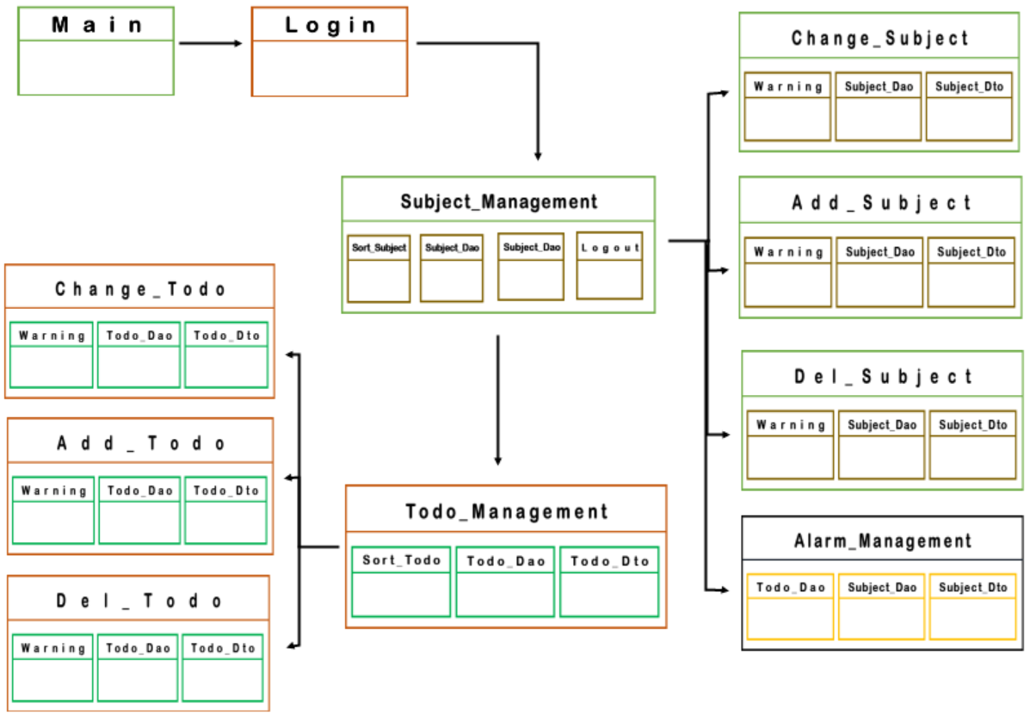
To Do List Program

